Slide 1

Pierwsze programy w VBA Excel-a
Notes:
https://www.pcmag.com/how-to/22-excel-tips-for-becoming-a-spreadsheet-pro

Slide 2
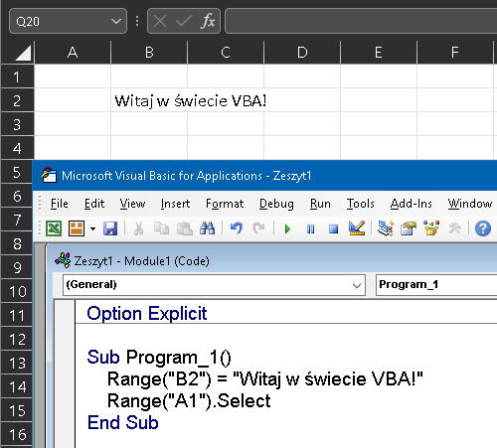
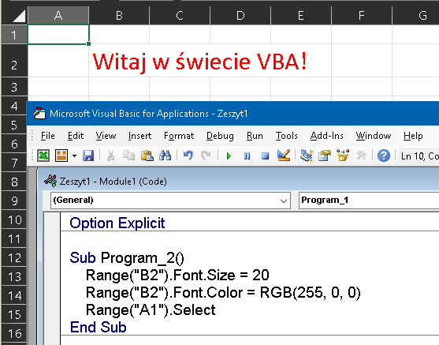
Pierwsze programy
Notes:
Sub Program_1()
Range("B2") = "Witaj w świecie VBA!"
End Sub

Slide 3
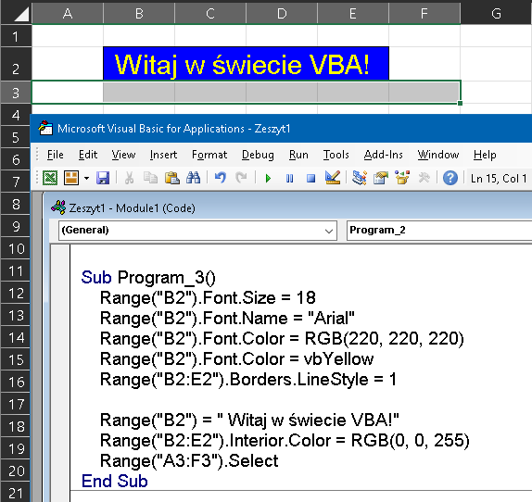
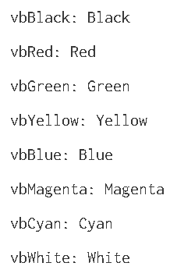
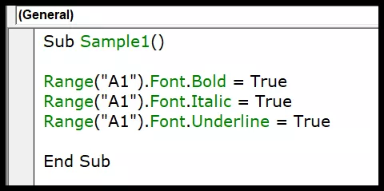
xlContinuous - Continuous line
xlDash - Dashed line
xlDashDot - Alternating dashes & dots
xlLineStyleNone - No line
xlSlantDashDot - Slanted dashes.
Range("A1").Font.Strikethrough = True
Range("A1").Font.Subscript = True
Range("A1").Font.Superscript = True
Notes:
Sub Program_3()
Range("B2").Font.Size = 18
Range("B2").Font.Name = "Arial"
Range("B2").Font.Color = RGB(220, 220, 220)
Range("B2").Font.Color = vbYellow
Range("B2:E2").Borders.LineStyle = 1
Range("B2") = " Witaj w świecie VBA!"
Range("B2:E2").Interior.Color = RGB(0, 0, 255)
Range("A3:F3").Select
End Sub

Slide 4
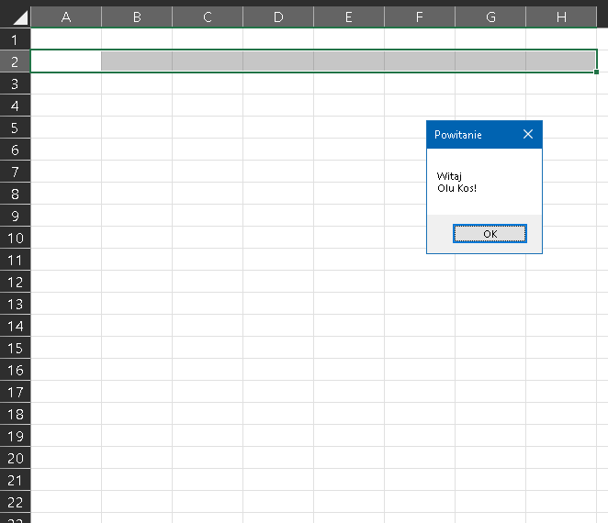


Slide 5
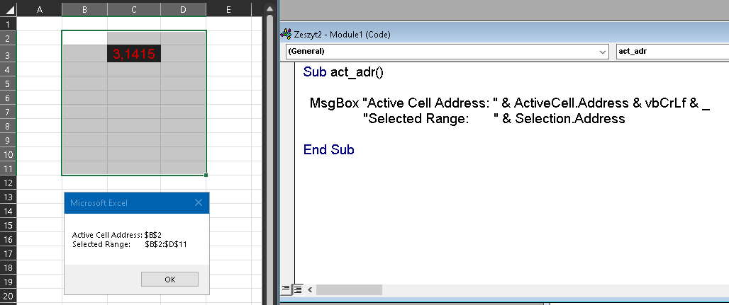

Adresy w VBA
Address to własność obiektu Range, która zwraca lokalizację w arkuszu. Standardowe zastosowanie tego argumentu zwraca ciąg tekstowy przedstawiający adres komórki/zakresu z zastosowaniem odwołania bezwzględnego.
Notes:
Sub act_adr()
MsgBox "Active Cell Address: " & ActiveCell.Address & vbCrLf & _
"Selected Range: " & Selection.Address
End Sub

Slide 6
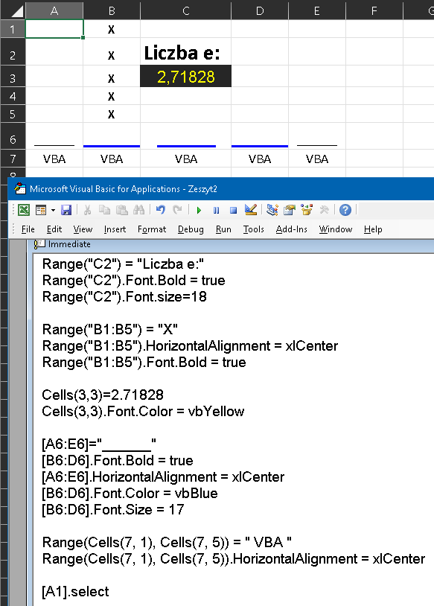
Adresy w VBA
Jeśli chcemy wprowadzić wartość do komórki, to najpierw musimy tę komórkę zaadresować przy pomocy polecenia
Cells (komórka) lub
Range(zakres).
Za pomocą Cells adresujemy jedną komórkę,
za pomocą Range zakres (z 1+komórek).
Notes:
Range("C2") = "Liczba e:"
Range("C2").Font.Bold = true
Range("C2").Font.size=18
Range("B1:B5") = "X"
Range("B1:B5").HorizontalAlignment = xlCenter
Range("B1:B5").Font.Bold = true
Cells(3,3)=2.71828
Cells(3,3).Font.Color = vbYellow
[A6:E6]="______"
[B6:D6].Font.Bold = true
[A6:E6].HorizontalAlignment = xlCenter
[B6:D6].Font.Color = vbBlue
[B6:D6].Font.Size = 17
Range(Cells(7, 1), Cells(7, 5)) = " VBA "
Range(Cells(7, 1), Cells(7, 5)).HorizontalAlignment = xlCenter
[A1].select

Slide 7
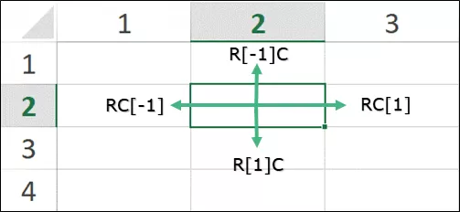
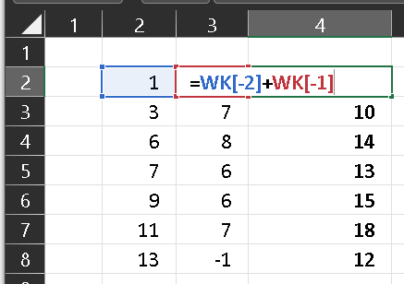
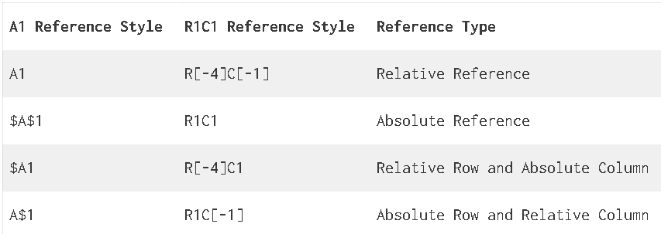
Adresy w VBA, styl R1C1
Notes:
Range("C2") = "Liczba e:"
Range("C2").Font.Bold = true
Range("C2").Font.size=18
Range("B1:B5") = "X"
Range("B1:B5").HorizontalAlignment = xlCenter
Range("B1:B5").Font.Bold = true
Cells(3,3)=2.71828
Cells(3,3).Font.Color = vbYellow
[A6:E6]="______"
[B6:D6].Font.Bold = true
[A6:E6].HorizontalAlignment = xlCenter
[B6:D6].Font.Color = vbBlue
[B6:D6].Font.Size = 17
Range(Cells(7, 1), Cells(7, 5)) = " VBA "
Range(Cells(7, 1), Cells(7, 5)).HorizontalAlignment = xlCenter
[A1].select

Slide 8
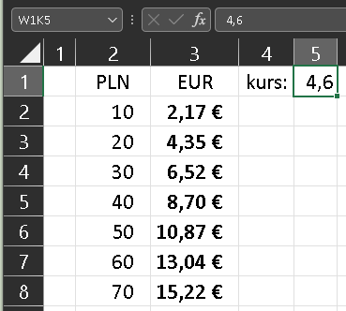
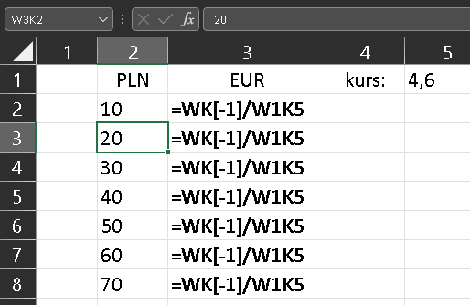
Adresy w VBA, styl R1C1
Notes:
Range("C2") = "Liczba e:"
Range("C2").Font.Bold = true
Range("C2").Font.size=18
Range("B1:B5") = "X"
Range("B1:B5").HorizontalAlignment = xlCenter
Range("B1:B5").Font.Bold = true
Cells(3,3)=2.71828
Cells(3,3).Font.Color = vbYellow
[A6:E6]="______"
[B6:D6].Font.Bold = true
[A6:E6].HorizontalAlignment = xlCenter
[B6:D6].Font.Color = vbBlue
[B6:D6].Font.Size = 17
Range(Cells(7, 1), Cells(7, 5)) = " VBA "
Range(Cells(7, 1), Cells(7, 5)).HorizontalAlignment = xlCenter
[A1].select

Slide 9
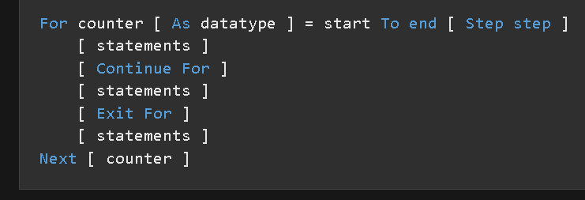
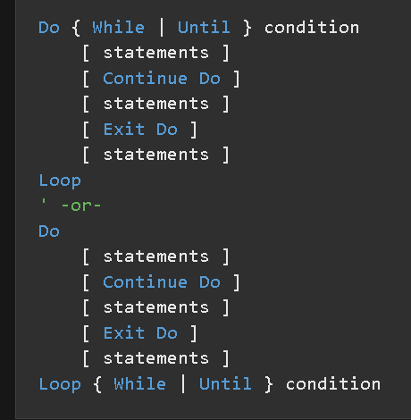
Loops - składnia

Slide 10
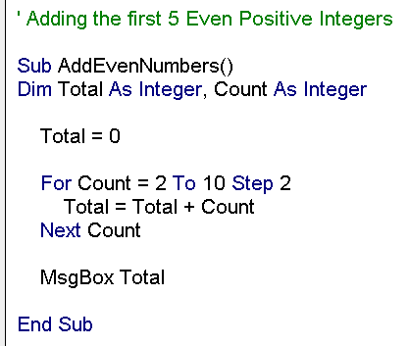
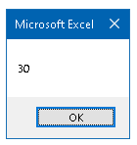
For … Next loop
Notes:
https://trumpexcel.com/vba-loops/
podnosić do ~u - to square
-------------------------------------------------------
' Adding the first 5 Even Positive Integers
Sub AddEvenNumbers()
Dim Total As Integer, Count As Integer
Total = 0
For Count = 2 To 10 Step 2
Total = Total + Count
Next Count
MsgBox Total
End Sub

Slide 11
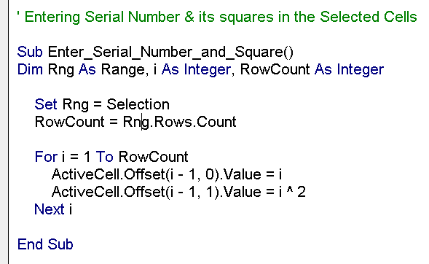
For … Next loop (2)
Notes:
' Entering Serial Number & its squares in the Selected Cells
Sub Enter_Serial_Number_and_Square()
Dim Rng As Range, i As Integer, RowCount As Integer
Set Rng = Selection
RowCount = Rng.Rows.Count
For i = 1 To RowCount
ActiveCell.Offset(i - 1, 0).Value = i
ActiveCell.Offset(i - 1, 1).Value = i ^ 2
Next i
End Sub

Slide 12
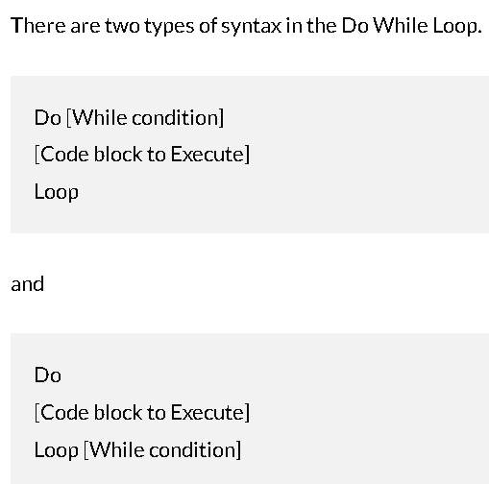
Do While Loop
allows you to check for a condition & run the loop while that condition is met (is TRUE).
the While condition is checked first before any code block is executed
the code block is executed first & then the While condition is checked.

Slide 13
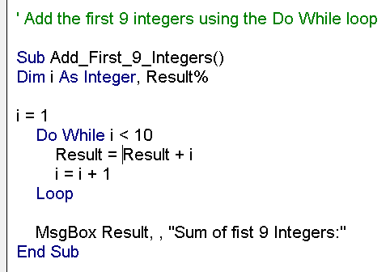
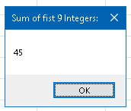
Do While Loop (2)
Notes:
' Add the first 9 integers using the Do While loop
Sub Add_First_9_Integers()
Dim i As Integer, Result%
i = 1
Do While i < 10
Result = Result + i
i = i + 1
Loop
MsgBox Result, , "Sum of fist 9 Integers:"
End Sub

Slide 14
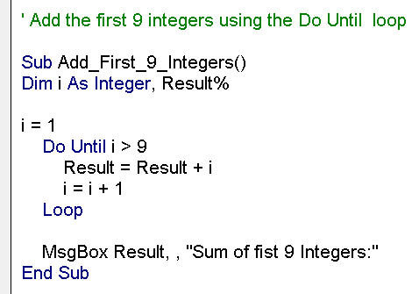
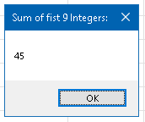
Do Until Loop
Notes:
' Add the first 9 integers using the Do Until loop
Sub Add_First_9_Integers()
Dim i As Integer, Result%
i = 1
Do Until i > 9
Result = Result + i
i = i + 1
Loop
MsgBox Result, , "Sum of fist 9 Integers:"
End Sub

Slide 15
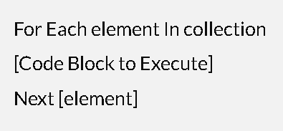
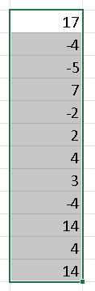
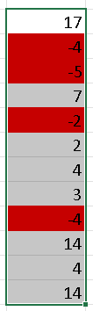
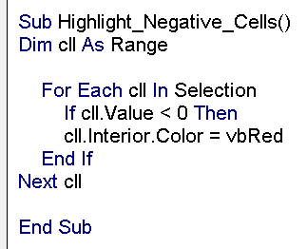
For Each-Next loop
Notes:
Sub Highlight_Negative_Cells()
Dim cll As Range
For Each cll In Selection
If cll.Value < 0 Then
cll.Interior.Color = vbRed
End If
Next cll
End Sub

Slide 16
Excel Macro Examples
Using the Code from Excel Macro Examples
How to Run the Macro
Excel Macro Examples
Unhide All Worksheets at One Go
Hide All Worksheets Except the Active Sheet
Sort Worksheets Alphabetically Using VBA
Protect All Worksheets At One Go
Unprotect All Worksheets At One Go
Unhide All Rows and Columns
Unmerge All Merged Cells
Save Workbook With TimeStamp in Its Name
Save Each Worksheet as a Separate PDF
Save Each Worksheet as a Separate PDF
Convert All Formulas into Values
Protect/Lock Cells with Formulas
Protect All Worksheets in the Workbook
Insert A Row After Every Other Row in the Selection
Automatically Insert Date & Timestamp in the Adjacent Cell
Highlight Alternate Rows in the Selection
Highlight Cells with Misspelled Words
Refresh All Pivot Tables in the Workbook
Change the Letter Case of Selected Cells to Upper Case
Highlight All Cells With Comments
Highlight Blank Cells With VBA
How to Sort Data by Single Column
How to Sort Data by Multiple Columns
How to Get Only the Numeric Part from a String in Excel

